Slide 1
ECE3411 Spring 2019
Case Study: Universal Battery Charger
Sung Yeul Park
Dept. Electrical & Computer Eng
Center for Clean Energy Engineering
University of Connecticut
April 17, 2019
Email: sung_yeul.park@uconn.edu

Slide 2
Topic A: Universal Adapting Battery Charger
The objective of this topic is to develop an efficient battery charger power supply capable of adapting to a range of applications. The requirement is a small plug-in power supply capable of automatically charging a wide range of battery configurations. This would reduce the needs for battery-charging devices in a typical home or office from several to as few as one.
Minimum requirements
Devices must operate without degradation or derating for input supplies ranging from 48 Hz to 440 Hz and 95 V to 270 V RMS.
Devices must adapt and successfully charge any of the following battery combinations without external settings, switches, or other user intervention. Tests of these combinations will use readily available commercial cells.
  Lead-acid cells, Nickel-cadmium cells, Nickel-metal-hydride cells, ithium-ion cells, single or series combinations up to five cells.
Charging currents up to 1 A must be possible at all voltages.
The charger must address the specific needs of each battery configuration, including but not limited to: no overcharge of lithium cells, appropriate end-of-charge action for each chemistry, etc.
External indication of “charging” and “charge complete” conditions.
Polarity-insensitive design. Batteries can be charged without trouble regardless of the connection polarity.
Protection against open-circuit and short-circuit conditions.
Device draws no more than 0.25 W when no battery is connected.
After battery charge is complete, devices draws no more than 0.25 W plus twice any power required for maintaining battery “float charge” if needed for a given chemistry.

Slide 3
Topic A: Universal Adapting Battery Charger
Minimum requirements
Power drawn during charging not to exceed 0.5 W plus double the power delivered to the battery terminals.
Input power factor not less than 0.7 under any circumstances, and not less than 0.8 during any battery charging condition under which the charging current exceeds 0.5 A. Details of power factor and power quality requirements will be posted on the web site.
The charging methods should meet manufacturers’ recommendations for each cell type.
Batteries can be connected whether or not power is available without damage (i.e. fully hot pluggable with no requirements for a particular connection sequence)
Delivered with adapter connectors for barrel-type dc power plugs as are provided on many small portable devices.
Manufacturing cost in high-volume production (>1 M units/year) not to exceed US$10.
Optional (bonus points awarded for any provided minimum requirements are met):
Operation from a vehicle dc outlet (12-15 V typical)
Device draws no more than 0.1 W when no battery is connected.
Charging currents up to 2 A.
Operation to nominal battery voltages up to 24 V (12 lead-acid cells, 20 nickel cells, 6 lithium cells)
Ability to support rechargeable alkaline cell combinations of two to four or more cells in series.
Size less than 15 cm x 6 cm x 3 cm, not including cords. Mass less than 0.4 kg.
Switch setting converts the unit into a fixed 12 V power supply at up to 1 A. Reverts to charging mode automatically when batteries are then connected.
Display indicates battery configuration and state of charge.
Efficiency above 75%, not including up to 0.1 W quiescent power.

Slide 4
Specification of the Universal Battery Charger
S.No. | Description | Specification | Units
1 | Voltage range | 95 – 270 V | Vrms
2 | Frequency range | 48 – 440 | Hz
3. | types | Lead-acid, Lithium-ion, Nickel-Cadminum, Nickel-Metal-Hydride
4. | Nominal battery voltage range | 2-18 | V
5. | Peak charging current | 1 | A
6. | Connector | Barrel type dc jack
7. | Peak stand-by power | 0.25 | W
8. | Charged state power consumption | 0.25 + 2×(Power to maintain float charge) | W
9. | Charging state power consumption | 0.5 + 2×(Power supplied to ) | W
10. | External indication | Charging / Charge complete
11. | Polarity sensitivity | insensitive
12. | Protection | Open circuit / Short circuit
13. | Input power factor | > 0.8 for Charging current > 0.5 A
14. | Power quality standards | IEC-61000-3-2
15. | Connection sequence | Fully Hot pluggable
16. | Shipping suitability | Common carrier shipment
17. | High volume production cost (>1M units/ year) | $10 | USD

Slide 5
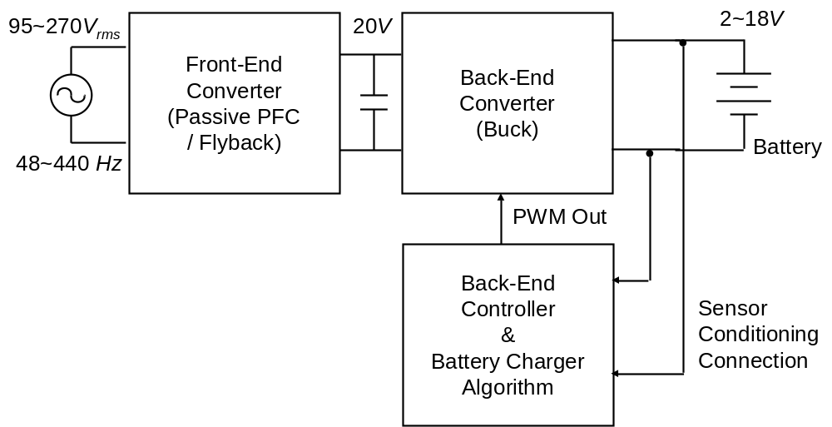
Microcontroller Based Universal Battery Charger
Commercial IC
for front-end control:
AC to DC conversion
AVR chip
for back-end control:
DC to DC conversion

Slide 6
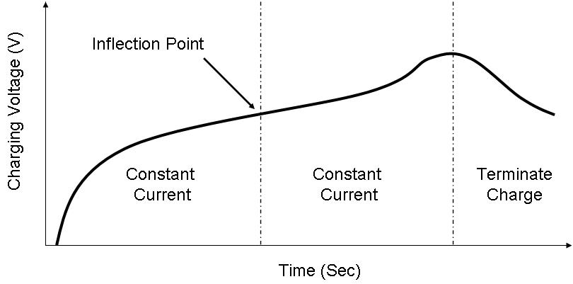
Charging Profiles for Battery (1)
General Ni-MH / Ni-Cd Charging profile

Slide 7
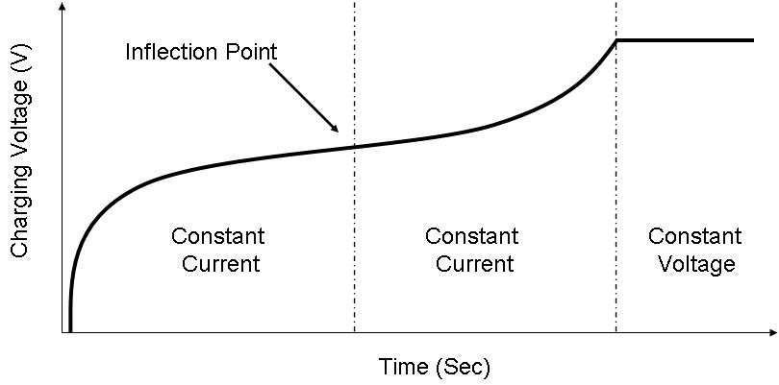
Charging Profiles for Four Battery (2)
General SLA / Li-Ion Charging Profile

Slide 8
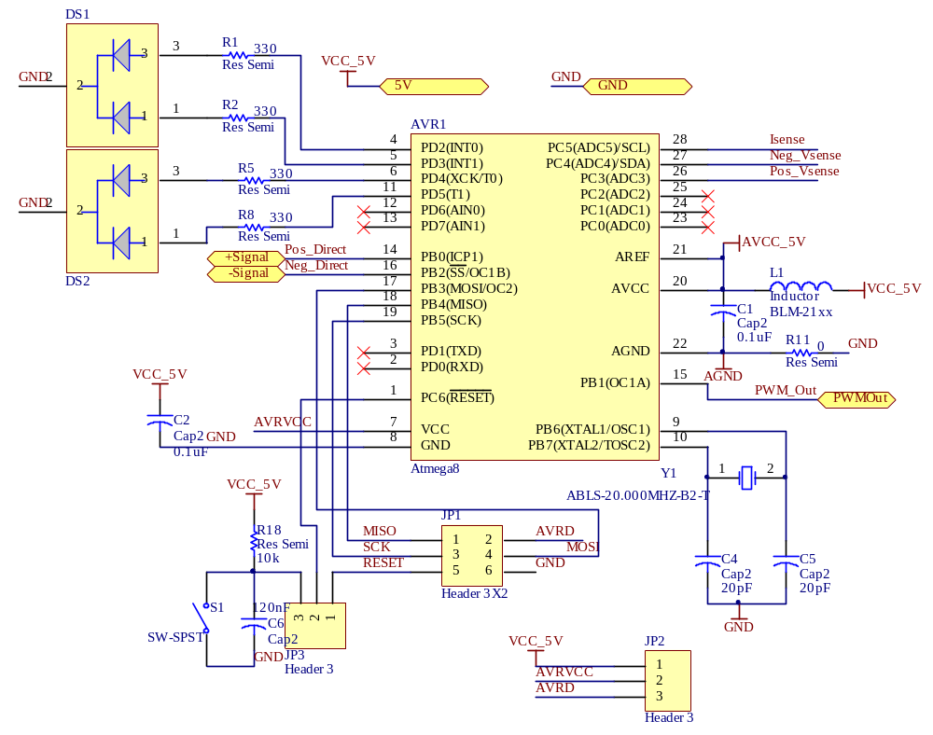
AVR Design Schematic for Battery Charger

Slide 9
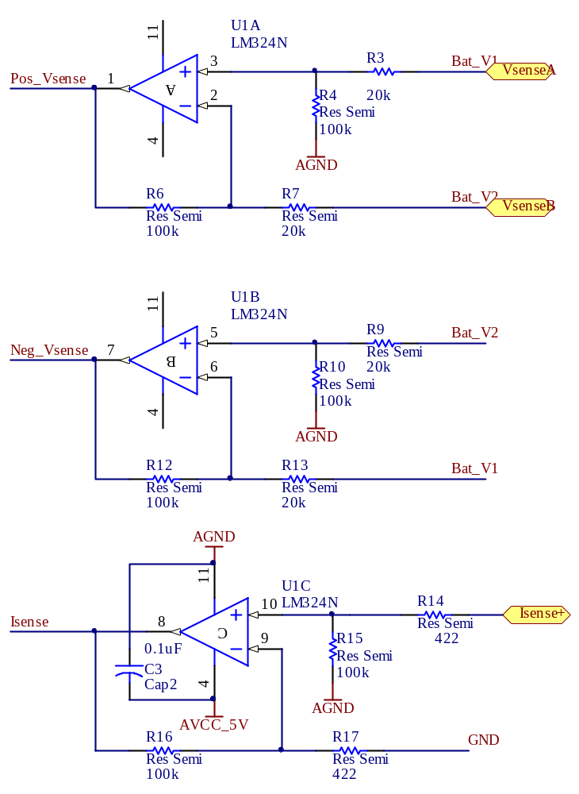
Voltage, Current Sensing Circuit for Battery Charger

Slide 10
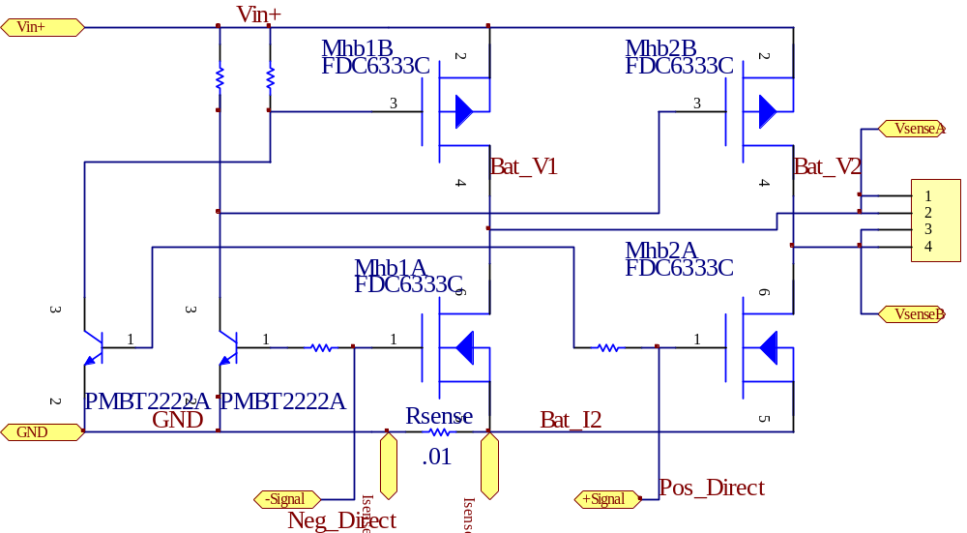
Full Bridge Schematic

Slide 11
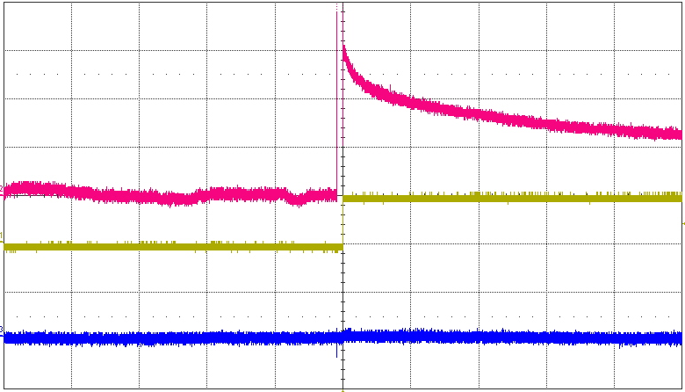
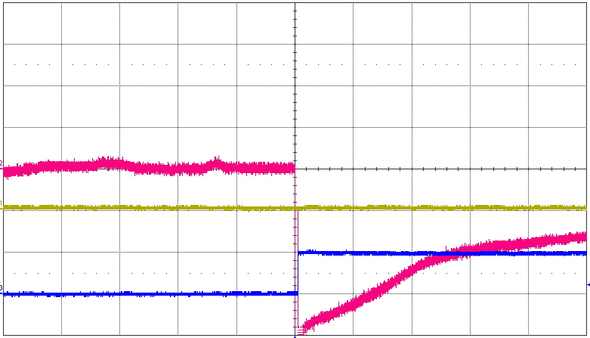
Full Bridge Test with Battery polarity
Vbat(1V/div)
Control Signal 1(5V/div)
Control Signal 2(5V/div)
Vbat(1V/div)
Control Signal 1(5V/div)
Control Signal 2(5V/div)
Time(2ms/div)

Slide 12
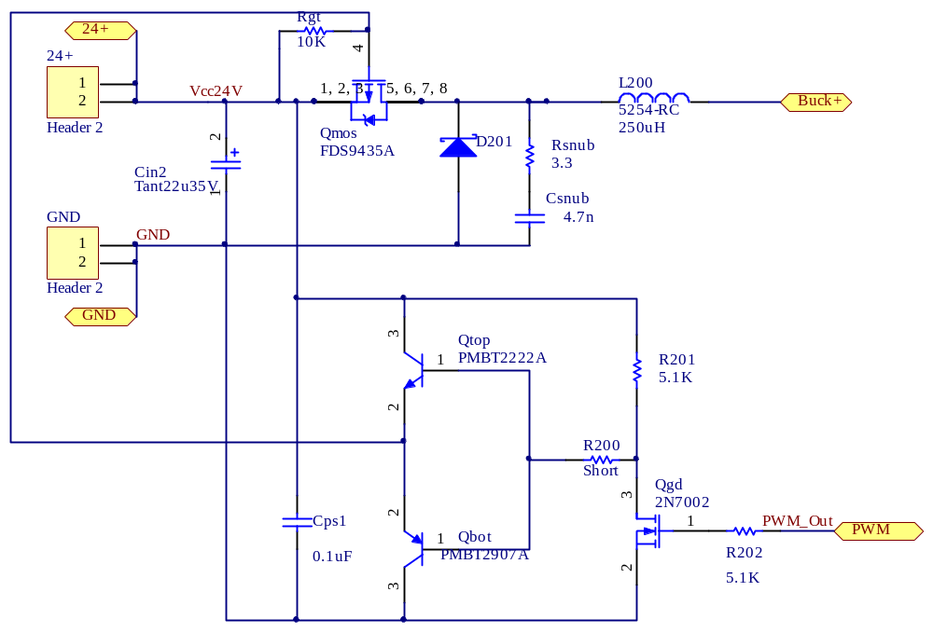
Battery Charger Schematic

Slide 13

AVR Coding (1)

Slide 14
AVR Coding (2) - Define
#include <avr\io.h>
#include <avr\interrupt.h>
#include <stdio.h>
#define BitSet(x,y) ((x) |= (y))
#define BitClear(x,y) ((x) &= ~(y))
#define BitCheck(x,y) ((x) & (y))
#define BitToggle(x,y) ((x) ^= (y))
#define Ready 1
#define Charging 2
#define Complete 3
#define Isense 1
#define Vpos_sense 2
#define Vneg_sense 3
#define Bit0 0b00000001
#define Bit1 0b00000010
#define Bit2 0b00000100
#define Bit3 0b00001000
#define Bit4 0b00010000
#define Bit5 0b00100000
#define Bit6 0b01000000
#define Bit7 0b10000000
#define Mux3 0b00000011
#define Mux4 0b00000100
#define Mux5 0b00000101
#define LED1_On BitSet(PORTD, Bit2)
#define LED1_Off BitClear(PORTD, Bit2)
#define LED1_Status BitCheck(PIND, Bit2)
#define LED2_On BitSet(PORTD, Bit3)
#define LED2_Off BitClear(PORTD, Bit3)
#define LED3_On BitSet(PORTD, Bit4)
#define LED3_Off BitClear(PORTD, Bit4)
#define LED3_Toggle BitToggle(PORTD, Bit4)
#define LED4_On BitSet(PORTD, Bit5)
#define LED4_Off BitClear(PORTD, Bit5)
#define Pos_Direct_On BitSet(PORTB, Bit0)
#define Pos_Direct_Off BitClear(PORTB, Bit0)
#define Neg_Direct_On BitSet(PORTB, Bit2)
#define Neg_Direct_Off BitClear(PORTB, Bit2)
#define Vpos_Set BitSet(ADMUX, Mux3)
#define Vpos_Clear BitClear(ADMUX, Mux3)
#define Vneg_Set BitSet(ADMUX, Mux4)
#define Vneg_Clear BitClear(ADMUX, Mux4)
#define I_Set BitSet(ADMUX, Mux5)
#define I_Clear BitClear(ADMUX, Mux5)
#define ADEN_Set BitSet(ADCSRA, Bit7)
#define ADSC_Set BitSet(ADCSRA, Bit6)
#define ADIF_Clear BitSet(ADCSRA, Bit4)
#define REFS0_Set BitSet(ADMUX, Bit6)
#define ADLAR_Set BitSet(ADMUX, Bit5)
#define PWM_On BitSet(PORTB, Bit1)
#define PWM_Off BitClear(PORTB, Bit1)

Slide 15
AVR Coding (3) - Init
#define On 1
#define Off 0
#define Positive 1
#define Negative 0
// Mode Definition
#define Pos_I_Charging_Mode 1
#define Neg_I_Charging_Mode 2
#define Pos_V_Charging_Mode 3
#define Neg_V_Charging_Mode 4
#define Pos_Complete_Mode 5
#define Neg_Complete_Mode 6
void Setup(void);
void Current_Mode (void);
void Timer2(void);
void Ready_Algo(void);
void Charging_Algo(void);
void Complete_Algo(void);
void Vmeasure (void);
void ADC_Check(void);
void Pos_I_Charging_Algo(void);
void Neg_I_Charging_Algo(void);
void Pos_V_Charging_Algo(void);
void Neg_V_Charging_Algo(void);
void Pos_Complete_Algo(void);
void Neg_Complete_Algo(void);
int Vbat,tcount,t_sec,t_minsec,zcount,minflag,twohourcount,PWM_flag,flag,Vout,Vprev,Vpres,secflag;
signed int Ierr,Vc,Vc_old,Ierrf,Vcf,Iref, Ierrs, Ierr_old;
char Vci, Mode, Null, ADC_Flag;
unsigned int Vpos_Data, Vneg_Data, I_Data;
int T_count;
char T_sec; // global seconds
char T_min; // global minutes
char T_hour; // global hour
char Flag_Sec, Flag_Sample, Flag_Bat_Algo;
char Mode;
void Initial_Setup(void)
{ // definition of PWM, Ports, UART and Real-Time-Clock
TCCR1A = 0x83; // define timer1 as 10-bit PWM
TCCR1B = 0x09; // Fast PWM Mode \
PORTC = 0x00; // Prepare Port C as analog input
DDRC = 0x00; // with no pull-ups
ADMUX = 0x40; // ADC Reference Set to the Vcc
ADCSRA = 0x82; // Prescaler Clk/4, ADEN, ADIE set
PORTB = 0x00; //
DDRB = 0xFF; // Set PORTB as output
PORTD = 0x00; //
DDRD = 0xFF; // Set PORTD as output
DIDR0 = 0x3F; //disable digital input
PRR = 0x00; //A2; //enable PRADC
}

Slide 16
AVR Coding (4) - Main
while(1)
{
if(TIFR1 & 0x01)
{
TIFR1 |= 0x01;
I_Set;
ADSC_Set;
}
if(Flag_Sample == On)
{
Flag_Sample = Off;
Iref = 250;
//set current reference to 0.5 amps
Ierrf = Iref-I_Data; //working Current Integral gain = 0.1*Z/Z-1
Ierrs = Ierrf - 0*Ierr_old;
/*Vc = Ierr >> 4;*/
Ierr = Ierrs >> 7;
Vc = Vc_old + Ierr;
if (Vc<0) Vc = 0;
//limit control voltage to 8-bits
if(Vc>0x03FE) Vc = 0x03FE;
Vc_old = Vc;
Ierr_old = Ierrf;
OCR1A = Vc; //PWM
}
}
}
int main (void)
{
char TFlag, ADC_char, temp_char, i, Flag_Ready;
int Vpos_Data_Sum, Vneg_Data_Sum, Vpos_Data[4], Vneg_Data[4], Vpos_Data_Avg, Vneg_Data_Avg;
int ADC_value;
Initial_Setup();
Null = Off;
LED1_Off;
LED2_Off;
LED3_Off;
LED4_Off;
Pos_Direct_Off;
Neg_Direct_Off;
PWM_Off;
T_count = 19512;
Flag_Sec = Off;
Flag_Ready = On;
Pos_Direct_On;
// Ready_Mode_Check
sei();
ADCSRA = 0x8A;
// Prescaler Clk/4, ADEN, ADIE set

Slide 17
AVR Coding (5) – ADC and ISR
void ADC_Check(void)
{
Vpos_Set; // Vpos ADC channel Selet
ADSC_Set; // Start of ADC conversion
while (!(ADCSRA & 0x10)){}; // Wait till conversion complete
ADIF_Clear; // ADIF bit clear by setting one
Vpos_Clear; // ADC channel clear for next ADC channel
Vpos_Data = ADCH; // Data save
Vneg_Set;
ADSC_Set;
while (!(ADCSRA & 0x10)){};
ADIF_Clear;
Vneg_Clear;
Vneg_Data = ADCH;
I_Set;
ADSC_Set;
while (!(ADCSRA & 0x10)){};
ADIF_Clear;
I_Clear;
I_Data = ADCH;
}
ISR (ADC_vect)
{
I_Clear;
I_Data = ADC;
Flag_Sample = On;
}

Slide 18
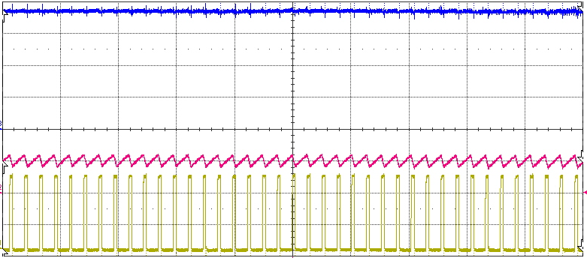
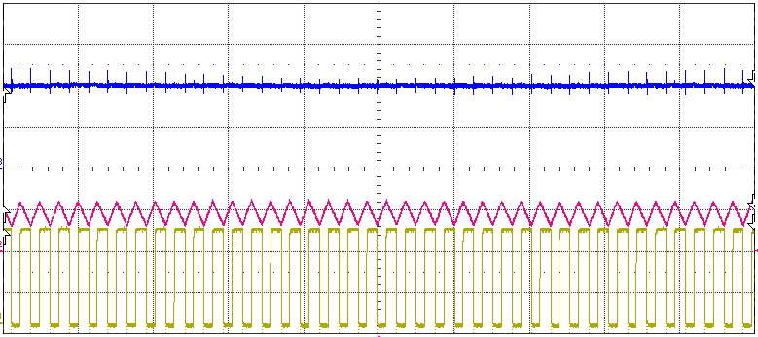
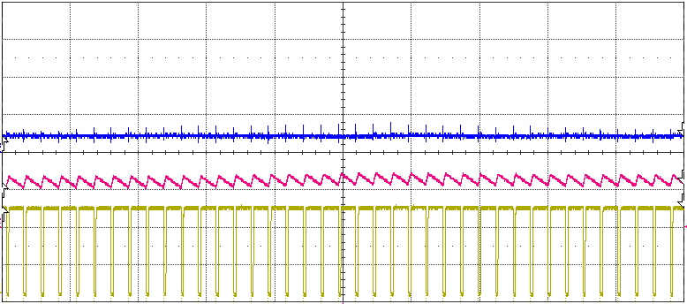
Charging 1A From 2V to 18V Level
V_{bat} (5V/div)
18V
I_{charging} (1A/div)
V_{PWM gate}(10V/div)
10V
2V
Time(200us/div)

Slide 19
Overall Battery Charging Algorithm Flowchart
Stage_0 : Check the Battery Polarity (Polarity LED indicator)
Stage_1 : CC Mode, inflection detection
(Status of Charging LED indicator)
Stage_2 : CC Mode, Threshold detection
Stage_3 : CV Mode, Termination detection (SLA, LiIon)
Stage_4 : Complete Charging
(NiMH, NiCd)
Stage_5 : Complete Charging
(SLA, Li-Ion)
Start
Initialization Variables
Initial Setup Timer, ADC, Flags
Stage 1 : Inflection Detection
Stage 2 : Threshold Detection
Stage 3 : Termination Detection
Stop

Slide 20
Battery Charging Algorithm : Inflection point
Stage 1 Start
Pre_1dv_flag = zero
Vadc_n – Vadc_o?
Positive
Negative
Zero
Flag_Pre_1dv = Positive
T_n = T_count
Dt_n = T_n – T_o
N
Flag_Pre_1dv = Negative?
Flag_Pre_1dv = Zero
Y
Bat_Type = NiMH
Bat Charger Stop
N
Flag_Pre_1dv = Negative
Dt_n < Dt_o?
Y
Termination Point
Dt_count++
N
Dt_count = 0
Dt_o = Dt_n
T_o = T_n
Dt_count > 2
Y
Mode = Stage II
Vref = 110% Vsense
Stage I Stop
Inflection Point

Slide 21
Battery Charging Algorithm : Threshold point
Stage 2 Start
Pre_1dv_flag = Positive
Vadc_n – Vadc_o?
Positive
Negative
Zero
Flag_Pre_1dv = Positive
N
Flag_Pre_1dv = Negative?
Flag_Pre_1dv = Zero
N
Y
Vref < Vadc?
Bat_Type = NiMH
Bat Charger Stop
Y
Flag_Pre_1dv = Negative
Dt_count++
N
Dt_count > 2
Dt_count = 0
Y
Termination Point
Mode = Stage III
Iref = 10% Irate
Stage II Stop
Threshold Point

Slide 22
Battery Charging Algorithm : Termination Point
Stage 3 Start
N
Bat_Type = NiMH
Bat Charger Stop
Iadc_n < Iadc_o?
Y
N
Iref < Iadc_n?
Y
Termination Point
Dt_count++
Dt_count > 2
N
Y
Bat_Type = SLA or Li-Ion
Bat Charger Stop
Dt_count = 0
N
Y
Fault
Bat Charger Stop
Timer Violation= On?

Slide 23
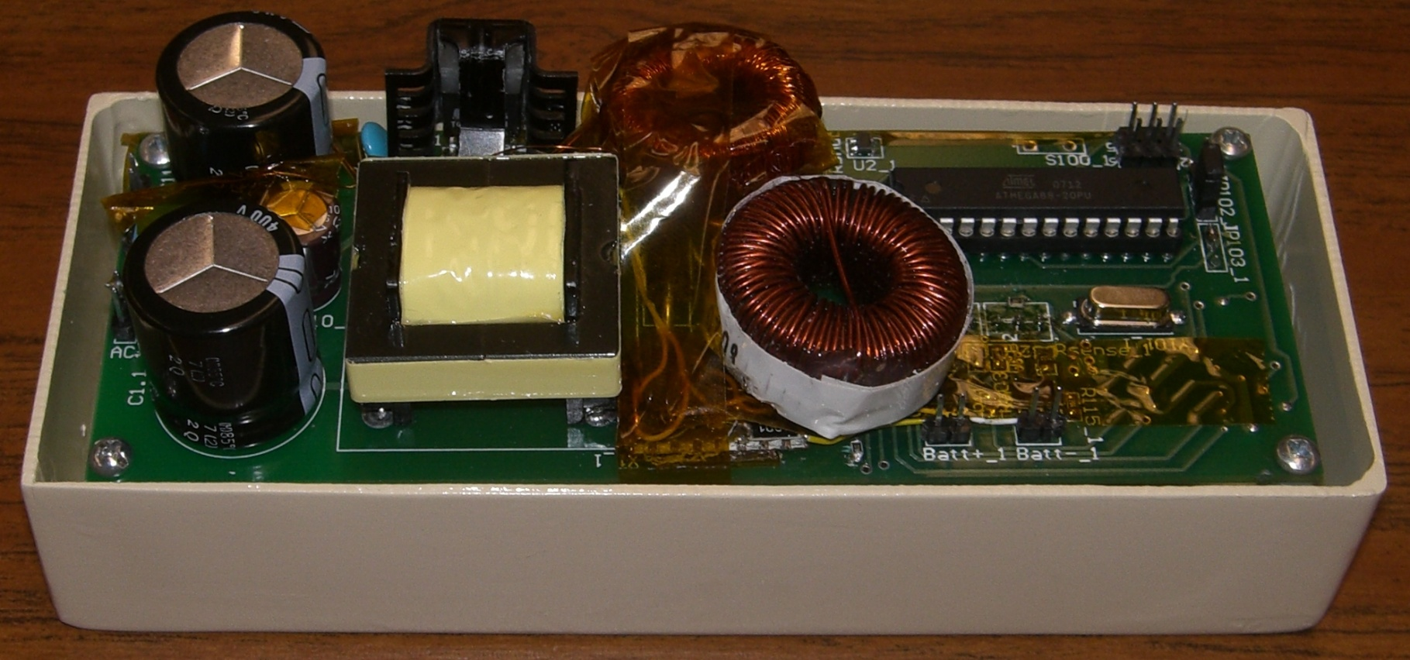
Universal Battery Charger
Front-End Converter
Back-End Converter
μcontroller
Full Bridge for
Polarity insensitivity

